Slide 1





One Planet Network
Executive Meeting – 30 and 31 May 2018
THE PROGRAMMES AND THE STRATEGY:
SUSTAINABLE TOURISM PROGRAMME
The Global Tourism Plastics Initiative is led by UNEP and UNWTO in collaboration with the Ellen MacArthur Foundation.

Slide 2







Why an initiative on plastic pollution for the tourism sector?
Increased waste
Loss of attractiveness
Lack of waste infrastructure
Biodiversity loss and animal and human health impacts
Much of the plastic used in tourism is made to be thrown away and often can’t be recycled
Plastics affect the attractiveness, and competitiveness of destinations
During peak tourist season in coastal destinations, marine litter was found to increase by 40%
Plastics are responsible for the deaths of millions of sea birds, sea mammals, marine turtles and fish, and impact human health
Pollution is one of the major environmental challenges of our times, together with biodiversity loss and climate change

Slide 3

What is the Global Tourism Plastics Initiative about?
Impacts in and beyond tourism
Common vision and framework
Circular economy of plastics
It is aligned with a broader framework applicable to other sectors and thus provides the opportunity to achieve impacts in and beyond tourism
It provides a common vision and framework for tourism stakeholders to address the causes of plastic pollution in a concerted manner
The initiative aims to support a shift towards a circular economy of plastics, where plastics never become waste

Slide 4







Which stakeholders can become signatories?
The problem of plastic pollution is too big for any organization to solve on its own. Therefore, everyone has a role to play.
Tour operators and platforms
Cruise lines
Destinations
Accommodation providers
Supporting organizations
Suppliers
Governments (national/local), businesses and civil society can become signatories.

Slide 5









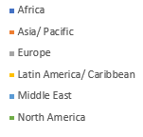
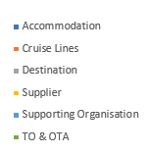
Key figures
145 signatories
108,82 million (> 804 metric tons) plastic items/ packaging eliminated
684,34 thousand (>20 metric tons) plastic items/ packaging replaced

Slide 6
What is expected from Accommodation providers?
1
2
3
4
Commit to collaborate and invest to increase recycling and composting rates
Report annually and publicly* on progress and volumes of plastics production/use
Endorse the Common Vision
By 2025, take action
Mandatory for large enterprises,
Encouraged for SMEs
Eliminate problematic & unnecessary plastic items & packaging.
Shift single use to reuse models or reusable alternatives
Engage the value chain to move to 100% of plastic packaging to be reusable, recyclable or compostable
Increase the amount of recycled content across plastic packaging and items
Notes:
*For businesses which are large enterprises reporting is mandatory on progress towards meeting the commitments in sections 2, 3 and 4 and will be made public on the website of Global Tourism Plastics Initiative.
For businesses which are micro, small and medium size enterprises (according to the definition of large enterprises in your country of registration), reporting is encouraged through their own reporting mechanisms and could be linked to the website of Global Tourism Plastics Initiative.

Slide 7
What is expected from governments and destinations?
1
Commit to integrate circularity in the use of plastics into our policies
Collaborate
with the private sector, NGOs, and other destinations
2
3
4
5
Promote the engagement of travellers
Publicly report and communicate on progress
Endorse the Common Vision
Stimulating elimination of problematic or unnecessary plastic packaging or items
Encouraging reuse models where relevant, to reduce the need for single-use plastic packaging and/or items
Promote/incentivise the use of reusable, recyclable, or compostable plastic packaging and/or items
Support initiatives that aim at increasing collection, sorting, reuse, and recycling rates, and facilitating the establishment of the necessary infrastructure and related funding mechanisms
Support initiatives that aim at stimulating the demand for recycled content across all plastic packaging and items used by 2025

Slide 8
What is expected from supporting organizations associations, business networks, NGOs, certification schemes, academia, consultancies, etc?
1
2
3
Communicate successes to affiliated organizations and businesses or partners, travellers and key local stakeholders.
4
5
Encourage affiliated organizations and businesses/ partners to join the GTPI
Advice and guide affiliated organizations and businesses/ partners to better manage plastics
Publicly report annually on progress of the implementation
Endorse the Common Vision

Slide 9
What is expected from tour operators, travel agents and platforms?
1
2
3
4
5
Advice and guide partners in the supply chain and at destination level to better manage plastics in their operations through practices, criteria, standards and/or policies.
Publicly report annually on progress of the implementation of their own commitment to the Global Tourism Plastics Initiative
Encourage partners in the supply chain and at destination level to join the Global Tourism Plastics Initiative.
Communicate successes to partners, suppliers, travelers, and key local stakeholders.
Endorse the Common Vision

Slide 10
The process of becoming signatories
Download the Signatory Pack for Accommodation Providers for additional guidance to develop your commitments.
Download the Terms of Reference of the Initiative to understand its background.
Prepare your commitments offline and get internal validation from Management.
Complete the online signatory form below for Accommodation Providers with the final version of your commitments. Please note that the signatory commitment form must be completed in one session and cannot be saved, so be sure to have all your information available at the time of commencing this form.
The Coordination Team will contact you with feedback or the final version of your commitments in PDF that you would need to return signed by your Management. It is strongly suggested that this commitment be signed by C-Level Leadership or equivalent.
1
2
3
4
5
6
Download and Read the Signatory Pack and Terms of Reference.
Prepare your commitments in a co-creation process
offline and get internal validation from Management.
Complete the online signatory form
GTPI reviews your commitments and give feedback
Submit your final commitments signed by your management
as well as proof of registration of your organization in your country (upon request of GTPI, doesn’t apply to destinations)
Announce your commitments publicly.
Notes:
Download and Read the Signatory Pack Accommodation Providers for additional guidance to develop your commitments and the Terms of Reference of the Initiative to understand its background.
Prepare your commitments in a co-creation process and get validation from Management and engagment of key stakeholders that are affected or affect by plastic pollution.

Slide 11
The benefits of tackling plastic pollution for the private sector
1
Increase profitability by reducing your costs and attract new travelers
4
Increase the resilience and sustainability of your business
2
Gain visibility and competitiveness by creating added value for your guest
5
Reinforce the collaboration with all your stakeholders along the value chain
3
6
Reduce your ecological impact by preserving and protecting your environment
Attract new investments

Slide 12





Get support to succeed on your journey
KNOWLEDGE MANAGEMENT
TOOLS FOR IMPLEMENTING YOUR COMMITMENTS
Develop & curate webinars and case studies
Trainings on plastics management
Research to support the Initiative’s strategy: Hotspots analysis of plastics(*), Policy and regulatory landscape at destinations
Information from specialized assessments
Development of Tools and methodologies to help you measure, monitor and report.
Sustainable procurement guidelines and tenders
LCA assessments of alternatives
Reporting template
COMMUNICATION
GTPI NETWORK
Visibility through our communication channels and platform
Communication activities showcasing the leadership of the sector
Awareness raising campaigns
Access to experts during webinars
Support from signatories' network
Support on technical aspects and coordination mechanisms

Slide 13


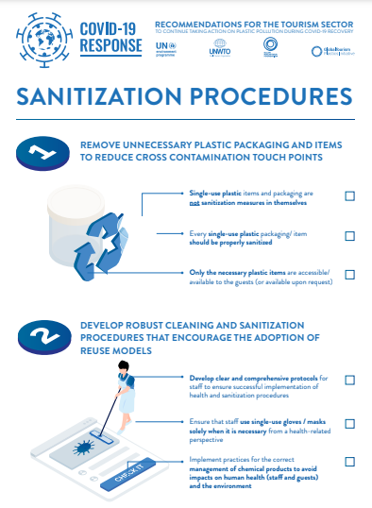
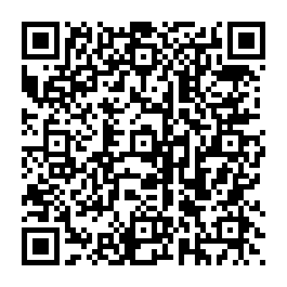

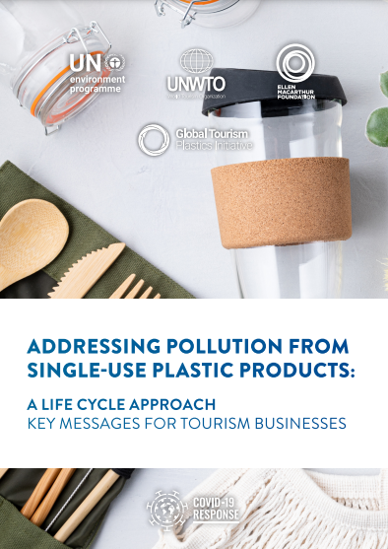
The Initiative provides tools and knowledge for signatories
Guidelines for tourism businesses and destinations
The repository of tools and resources aims to support signatories to implement their commitments and contains a variety of guidelines, training materials and reports.
Plastic reduction guidelines for hotels
Rethinking single-use plastic products in travel & tourism
Sanitization procedures for accommodation businesses by Booking.com
Recommendations for the tourism sector to continue taking action on plastic pollution during Covid-19 recovery
Addressing Pollution from Single-Use Plastic Products: A Life Cycle Approach - Key Messages for Tourism Businesses

Slide 14
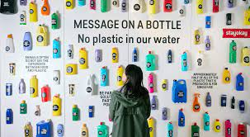
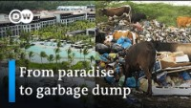



Increase your recognition in fighting plastic pollution.
Guidelines for reducing plastic consumption by Booking.com
AMResorts has completely eliminated the use of plastic straws and nearly all single-use plastic
Four benefits of reducing your plastic consumption
Iberostar Group has stopped generating 400 tons of plastic waste worldwide
120 hotels globally have rooms that are free of single-use plastics
Series of webinars to support tourism businesses to take action on plastic pollution
“Club Paradise Palawan harps on 'green practices’ “
Recycling nonbiodegradable waste and using biodegradable waste as fertilizer

Slide 15



Thank you
Please contact us
Svitlana Mikhalyeva
Coordinator One Planet Sustainable Tourism Programme
United Nations Environment Programme (UNEP)
France
Virginia Fernandez-Trapa
Programme Officer/ Sustainable Development of Tourism
World Tourism Organization (UNWTO)
Spain

Slide 16

One Planet Network
Executive Meeting – 30 and 31 May 2018
THE PROGRAMMES AND THE STRATEGY:
SUSTAINABLE TOURISM PROGRAMME
Join us

